Slide 1
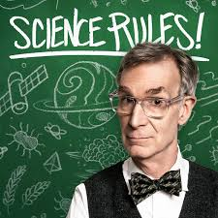
Science

Slide 2
Science is …

Slide 3
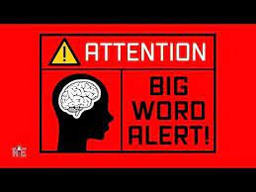
How does it work?
Science is a set of systematic process for understanding the natural or social world.
It operates according to a series of agreed upon principles (which we’ll get to shortly)
Underlying science is “empiricism”

Slide 4
Empiricism
Science is based on an empirical model of the world – one in which scientists and others believe that all knowledge is derived from our senses –our ability to see, hear, touch, taste & otherwise experience the world.
Science is observation. We observe things, compare our observations to the research literature, formulate ideas on how things might work & then set out to test our ideas through collecting data.
What is data? A series of observations based on other people’s knowledge, belief and experiences.

Slide 5
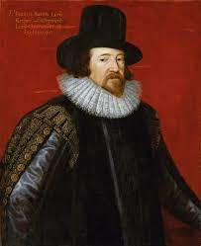
The Scientific Method
First outlined by Sir Francis Bacon (way back in the late 1500s/early 1600s)
Four step process:
1. make an observation;
2. formulate a testable statement (hypothesis);
3. test your idea;
4. draw conclusions and refine your ideas

Slide 6
The Scientific Method

Slide 7
Scientific principles

Slide 8
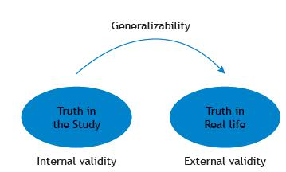
Validity
Validity – when researchers measure what they set out to measure.
Internal validity – the degree to which changes observed in a study are not the result of other factors (ie. did X really cause Y?)
External validity – the extent to which a study’s findings are generalizable to a larger population.

Slide 9
Spurious correlation as a validity problem
Confounding variables – extra factors that the researcher failed to control for or eliminate and that could be influencing the study’s findings.

Slide 10
“Correlation does not imply causation”

Slide 12
Tim Harford: On Lying with Statistics

Slide 13
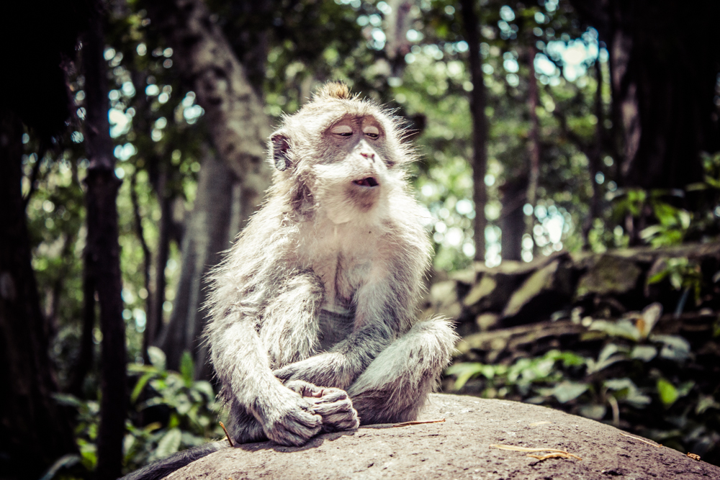
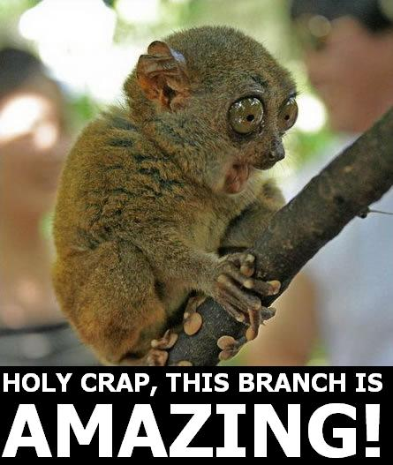
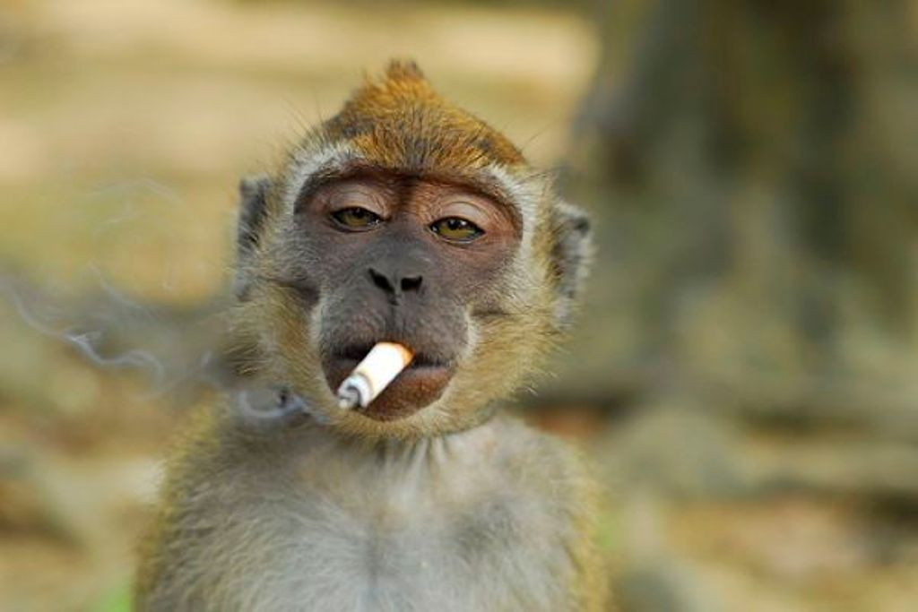
Another example of a validity problem: stoned monkeys

Slide 14
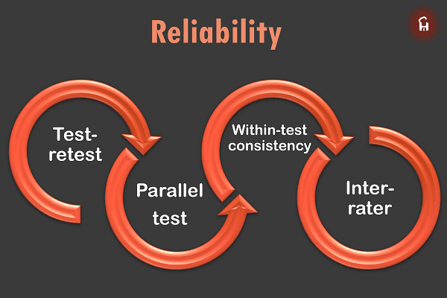
Reliability
Reliability – this term refers to the consistency, quality
and/or reproducibility of research findings. Study findings are highly
reliable if they consistently produce similar results when re-tested.

Slide 15
Testability
Testability refers to whether or not data collected through research can be analyzed or "tested" sufficiently to determine whether or not a claim can be falsified.
Another way to put it: testability refers to the content and quality of your data, ie. does the data you collected really answer your question?
E.g. peer support program evaluation & they collected data on when/how long peer supporters spent with staff members as an indicator of the program’s performance.

Slide 16
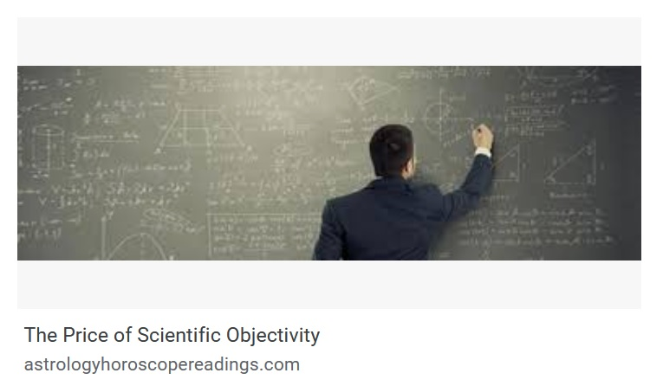
Objectivity
Objectivity refers to the goal of removing sources of human bias that might confound your results.
“The first principle is that you must not fool yourself and you are the easiest person to fool” - Richard Feynman

Slide 19
Parsimony
This refers to the idea that the simplest answer is usually the best.
Also known as Occam’s razor or the K.I.S.S. principle
Ex.: A lot of times people will explain an event by invoking a complex conspiracy involving multiple actors – and sometimes whole governments – when the answer is most likely incompetence, negligence or some other individual factor.
The more convoluted the answer, the less likely it is to be true.

Slide 20
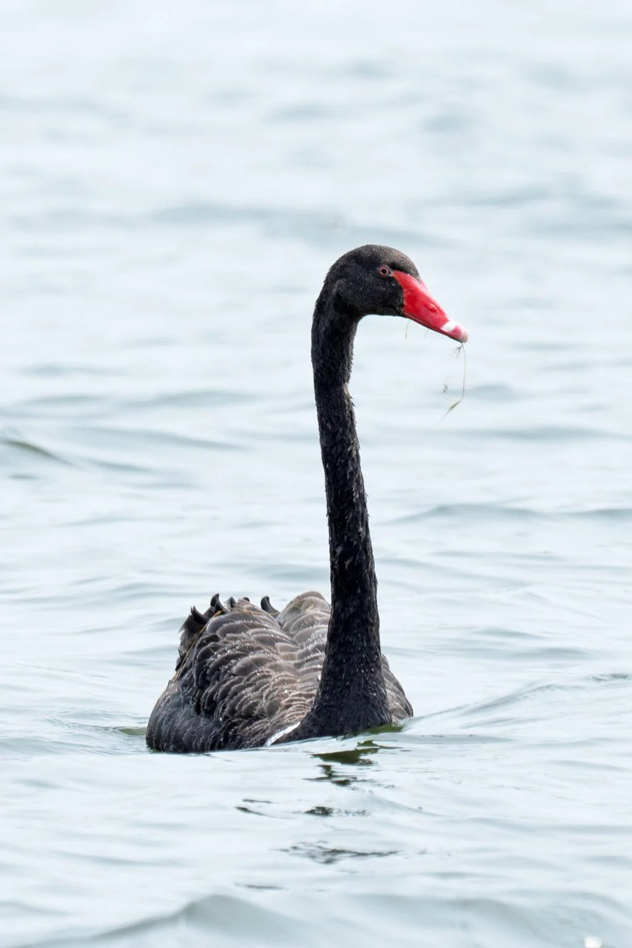
Falsifiability
Historically, scientists tried to prove things were TRUE (verifiability). However, a guy called Karl Popper said, “you’re doing it wrong”. An example of this is swans. If all you’ve ever seen are white swans does that mean all swans are white?
What the honk?

Slide 21
Which of these statements are falsifiable?
My dog is psychic
YES
Alien life forms control the human world from beyond the solar system
NO
Covid-19 is really a fake virus created by the government to scare people into giving up their rights.
YES
There is a ghost living in my attic
NO

Slide 22
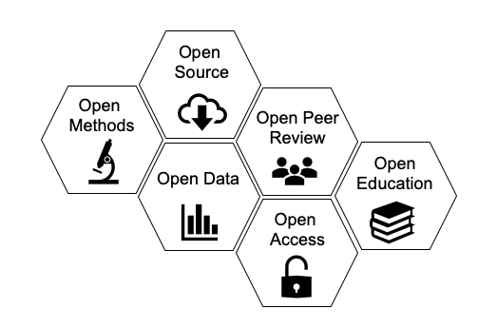
Transparency
Transparency refers to the research practice of fully documenting one’s study, including the methods, the data, the hypotheses/research questions and the findings. Another term we frequently see for this is ‘open science.’

Slide 23
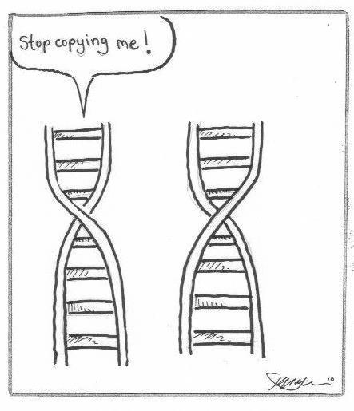
Scientific principle: replication (building an evidence base)
Replication – when a study uses the same methods as an original piece of research to see if a second (or third or fourth) study
achieves similar results. This strategy is used to build an evidence
base
Reproduction – a study that uses similar, but not the same
methods, as an original piece of research to see if similar results
can be achieved. These studies also help us to understand the
strengths and limitations of different interventions.

Slide 24
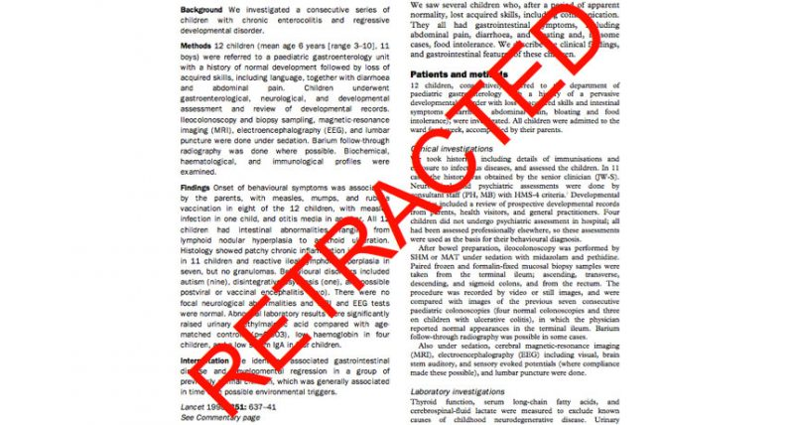
Why should we trust Science?
Transparency means we have a built-in error checking system: peer review; post-publication review and, increasingly, open science systems
A great source for knowledge about scientific error and fraud:
RETRACTION WATCH

Slide 25
Springer Nature retracted 44 papers from a journal in the Middle East after determining that they were junk. From Retraction Watch:
“The characteristics of rainfall in coastal areas and the intelligent library book push system oriented to the Internet of Things,” was purportedly written by Hailing Chi, of the library at the Zibo Vocational Institute in Shandong — which we loosely summarize as: “The rain in Spain falls mainly on my new smart refrigerator.”
And, perhaps our favorite, “Distribution of earthquake activity in mountain area based on embedded system and physical fitness detection of basketball,” which sounds like it might be the poorly-written elevator pitch for a new animated movie in which The Smurfs meet a volatile Shaq.

Slide 26
Does error/bias/fraud mean we shouldn’t be skeptical consumers of science knowledge?
NO

Slide 27
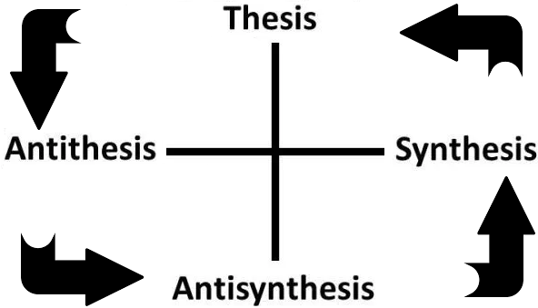
The other big thing science has going for it is …
Encouraging scientists and non-scientists alike to engage in critical thinking!!
Science advances when people find problems in existing theories/explanations and then work to resolve those issues.

Slide 28
When Scientists don’t agree: Global warming

Slide 29
What is the percentage of climate scientists who believe we are undergoing climate change?

Slide 30
Approx. 98.4% (Cook et al. 2004) Approx. 97-98% (Anderegg et al. 2012) Approx. 90% (Verheggen et al. 2014)

Slide 31
Study by Yale/George Mason (2017)

Slide 32
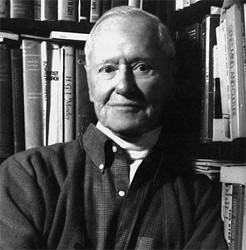
Merton’s 4 Scientific Norms:
Universalism: science is science and facts should be judged on their own merits no matter who is conducting the research or where.
Disinterestedness: scientists should be in the pursuit of knowledge for its own sake, and not for money, ego, reputation, or other benefits.
Communality: scientists should share knowledge so it can be improved and/or built upon.
Organized skepticism: no claim – including scientific ones – should be accepted at face value.

