Slide 1
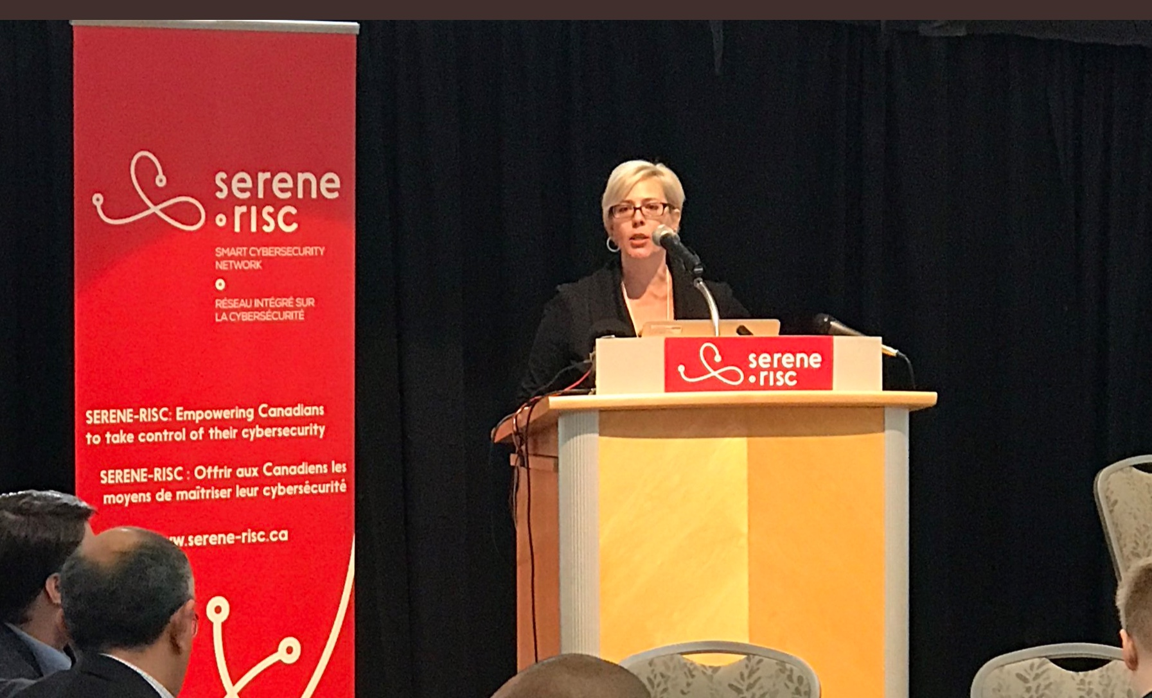
Policy environments

Slide 2
Before you can influence a policy shift you need to know a couple of important things:
1. what type of policy instrument is necessary
2. what level of government (or other organization) at which the change needs to be made
3. how policy is enacted by governments
4. who the actors are and where the possibilities for influence exist
5. How 1-4 translate into communicating to different audiences

Slide 3
1. What type of policy instrument are we looking at?

Slide 4
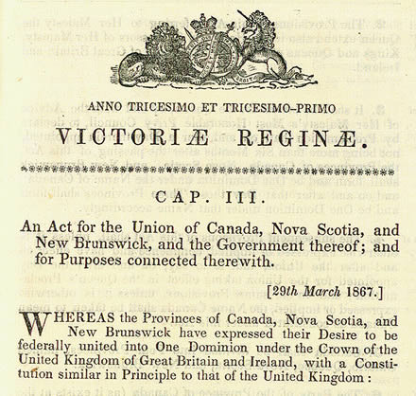
2. Federal versus provincial versus municipal responsibilities
British North America Act, 1867

Slide 5
3. Bills, statutes, regulations
Bill:
proposed piece of legislation
Statute:
enacted piece of legislation
Regulation:
government rule intended to guide decision-makers

Slide 6
3. How is public policy developed (bill process)

Slide 7
3. Regulations
Laws are the rules, whereas regulations are the ‘how tos’ for ensuring legal and other processes function.
Laws go through the formal bill process and are enacted, regulations do not.
Therefore individuals and groups who are trying to change a regulation do not need to have these changes implemented through the bill process.

Slide 8
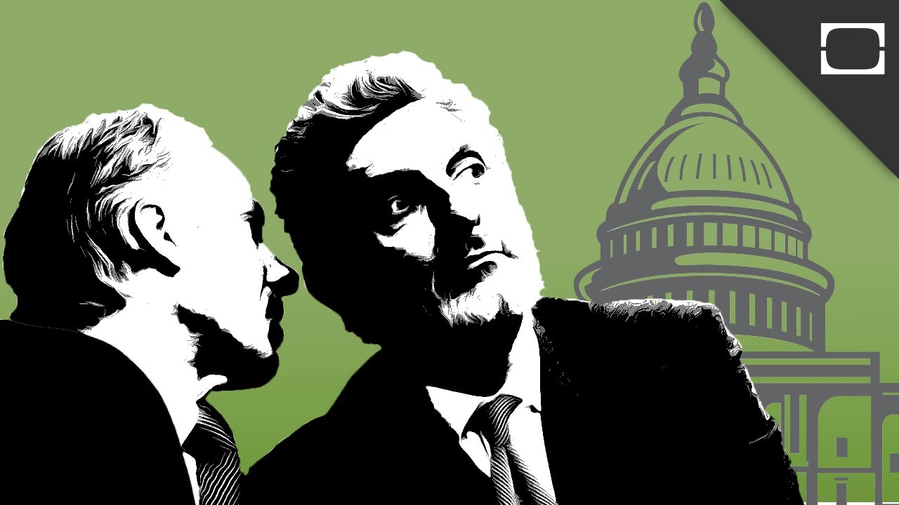
4. Some spaces of potential influence
Platform development (before parties select public positions)
Direct lobbying of elected officials
House and Senate Committees (writing/testimony)
White Papers
Through formal and informal consultation (ie. asked to develop research on a topic)

Slide 9
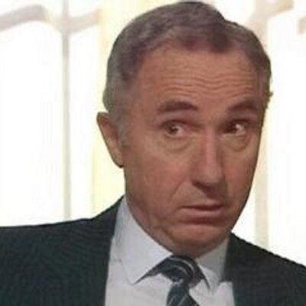
4. Actors - Government
Elected officials - Cabinet Ministers/Private members (bills)
Ministries –mandarins (bureaucrats)/lawyers
https://www.youtube.com/watch?v=884qXhIqsKU
Govt agencies

Slide 10
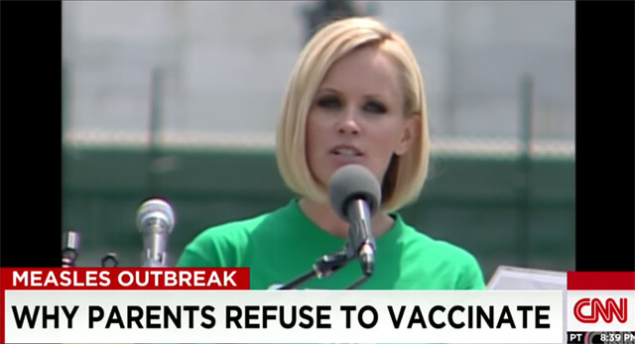
Issue advocates
Moral entrepreneurs (Howard Becker) – individuals/groups
Academics
non-profit - professional/volunteer (Sierra club/unions/ professional grps vs. cmty group)
Profit - Special interest or lobby groups

Slide 11
5. Audiences for research
Media
Practitioners
External
Audiences
Internal
audiences
Functions:
Shape policies & practices
Influence levels of support for policy options
Other academics
Government
Community
Students
Industry
Other potential audiences
Other
Our usual audiences
Who we could be speaking with
By L. Huey (modified version of work by Duarte 2008)

Slide 12
Aines & Aines 2019

Slide 13
The typical disconnect in communications:

Slide 14
Stolen from Ray Pawson (nd).

Slide 15
Hokkanen (2017)

Slide 16
Policy-making constraints (Puskur & Adenew 2011)
Policy making process is less known for taking evidence from grassroots or research and (through M&E)
Lack of adequate and current datasets
Lack of adequate analytical skills, models and knowledge
Lack of independence in policy analysis, i.e., bias towards promoting only government or donors’ interest
Lack of informed debate among the various stakeholders
Weak networking between the different stakeholders

Slide 17
A big stumbling block? Us. We need to become better communicators (Puskur 2006)
Research can only affect policy in a significant way if it is appropriately communicated.
■ Research results need to be well understood by key stakeholders and have to reach them before decisions have been taken.
■ Multiple approaches need to be pursued.

Slide 18
One thing we can do right away:
STOP using the phrase ‘dumbing it down’
when talking about science communication

Slide 19
*break time*

