Slide 1
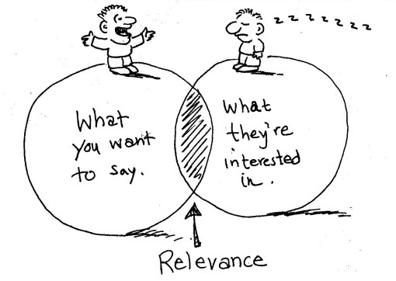
Communicating for different audiences, Part II

Slide 2
Blogs

Slide 3
Key elements of successful blogs
Write about what you’re passionate about *
Offer value *
Good marketing
Encourage interaction
Lots of images *
Easy reading *
Interesting titles *
Regular updates
Well-written AND spell and grammar checked *

Slide 4
Twitter and Tweeting
Keep it simple
Pics help
Being funny helps
Animals pics really help
The more you use it to engage with others, the bigger your network grows
Try to have some personality!

Slide 5
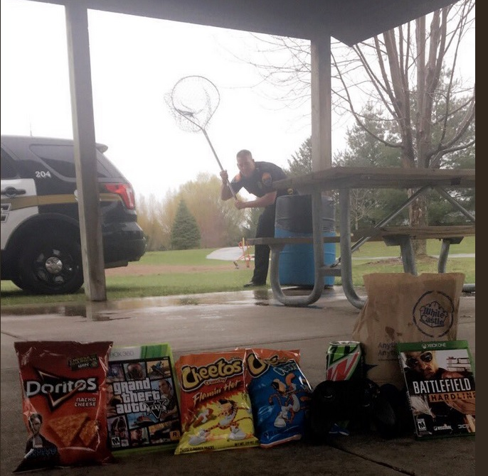

Slide 6
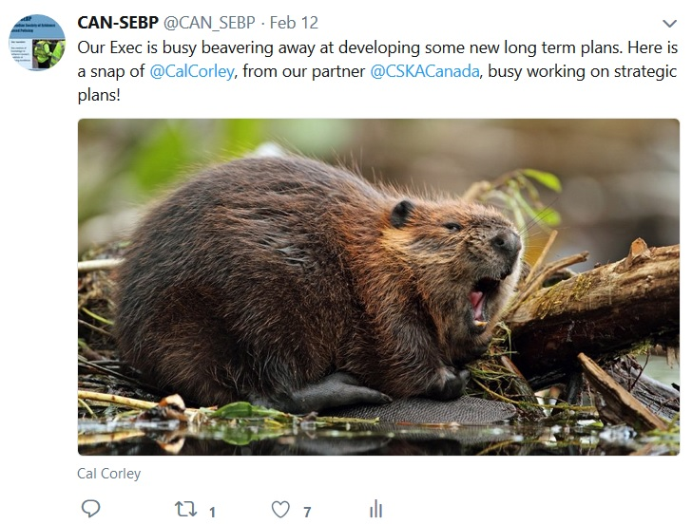

Slide 7
CVs

Slide 10
LinkedIn

Slide 11
Common mistakes
Typos
No picture
The wrong kind of picture
Blah profile headline
You’re not reaching out to the right people to build your network
No summary
No details
No politics/no dating
Using stupid terms like ‘thought leader’ or ‘disruptive thinker’

Slide 12
Um … confidence good, arrogance not so much

Slide 13
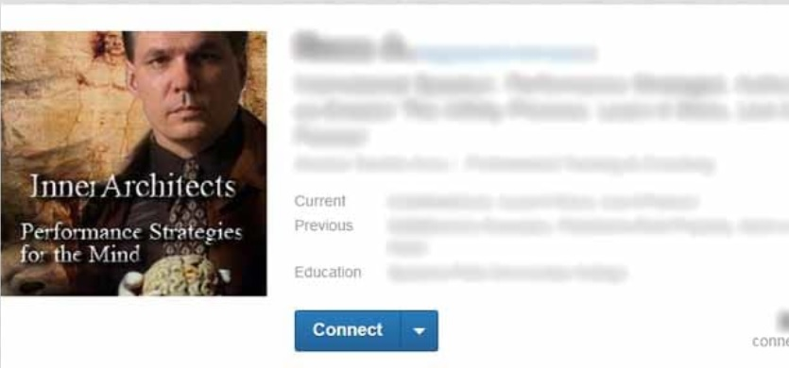
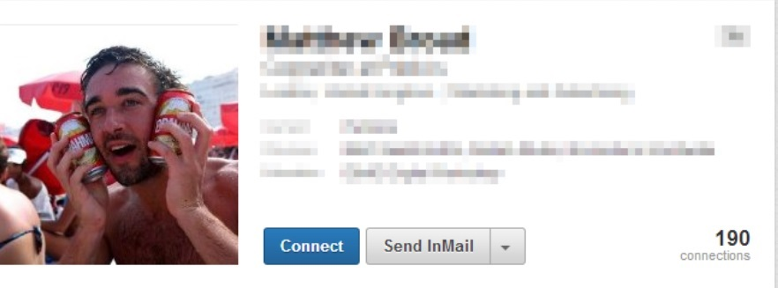
Inappropriate pics

Slide 14
Stupid titles

Slide 15
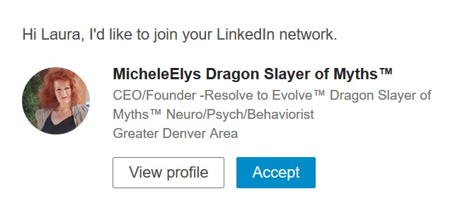
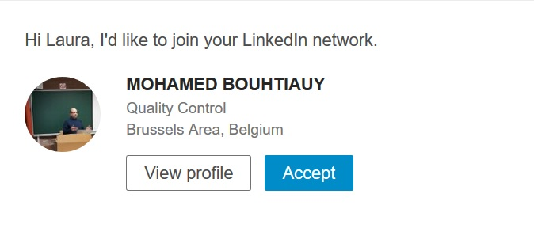
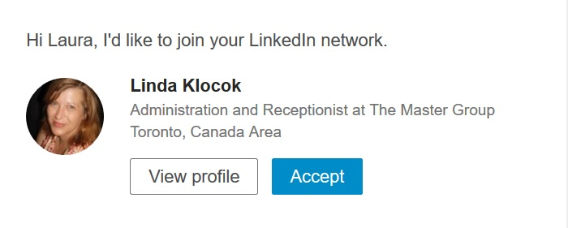
Requests I’ve rejected lately

Slide 17
*break time*

