Slide 1
Struggling against emotions, rhetoric and just plain bad ideas

Slide 2
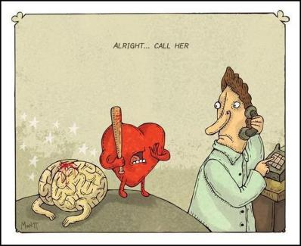
Politics: Reason vs. Emotion
There is a significant volume of research that suggests that our political behavior, beliefs and values are governed mainly by emotion, and not reason. You can see some of this play out in response to police decision-making and research.

Slide 3
The Role of Emotions in Judgement/Decision-making
Integral emotions influence decision making: emotions arising from the present situation (but influenced by previous experience/knowledge). Eg. donating to an animal cause, even though you can’t afford it, because you love dogs.
Incidental emotions: emotions carrying over from one situation to the next, affecting decisions that should be unrelated to that emotion. Eg. Being anti-immigrant because you feud with an Italian neighbour.
- Lerner et al. 2015

Slide 4
The role of fear/anger
“anger scores high on the dimensions of certainty, control, and others’ responsibility and low on pleasantness. These characteristics suggest that angry people will view negative events as predictably caused by, and under the control of, other individuals.
In contrast, fear involves low certainty and a low sense of control, which are likely to produce a perception of negative events as unpredictable and situationally determined. These differences in appraisal tendencies are particularly relevant to risk perception; fearful people tend to see greater risk, and angry people tend to see less risk.” (Lerner et al. 2015)

Slide 5
The Vaccine Wars

Slide 6
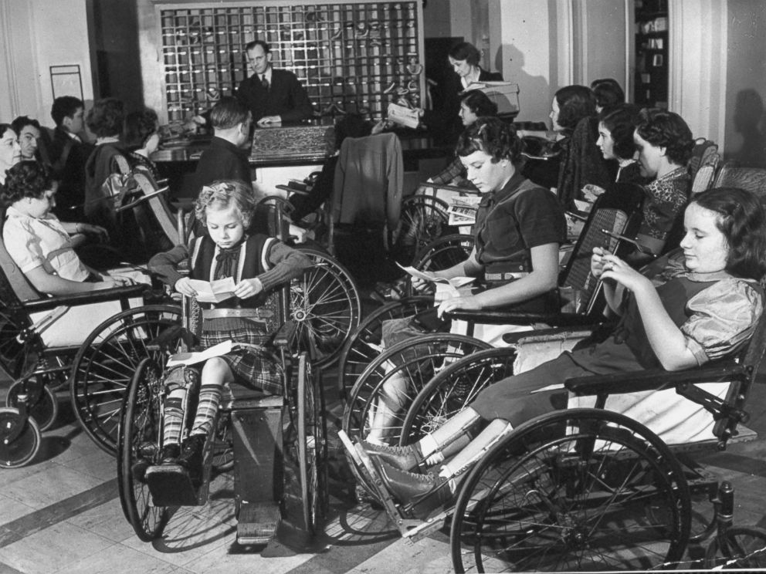
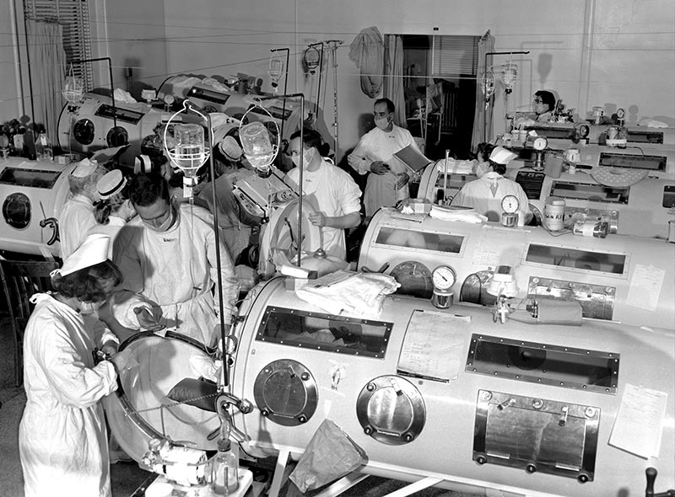
Polio

Slide 7
Measles and Mumps

Slide 9
The vaccine ‘theory’ of autism

Slide 10
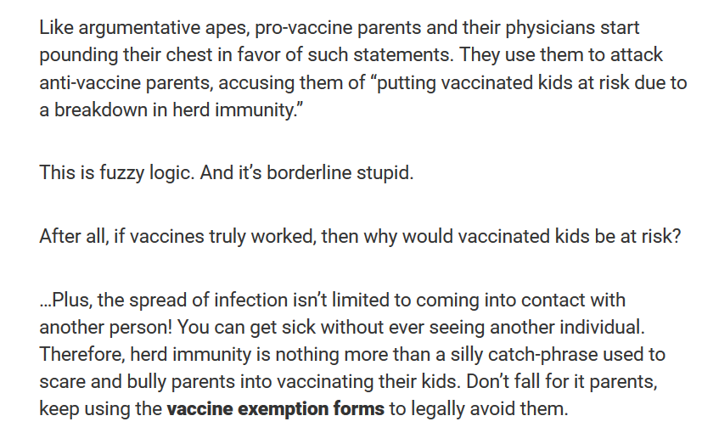
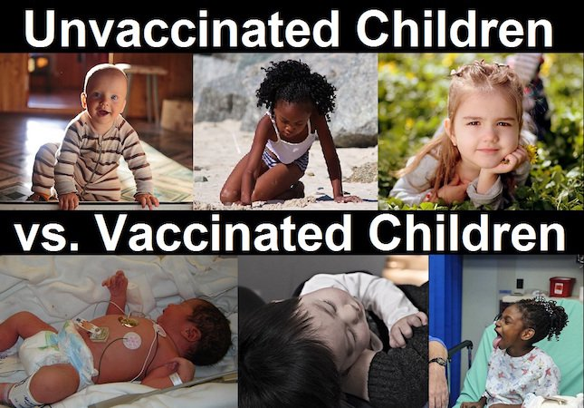

Slide 13
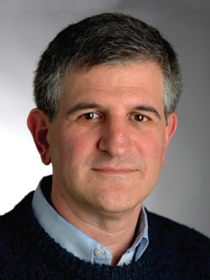
Paul A. Offit is an American pediatrician specializing in infectious diseases, vaccines, immunology, and virology.

Slide 14
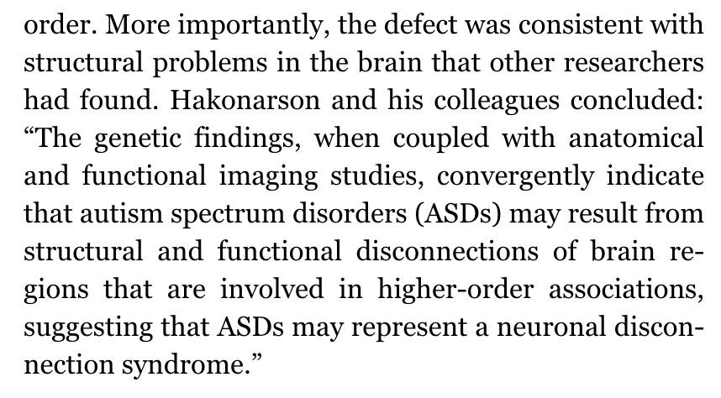

Slide 15
Exercise (stolen from Fred Phillips)
Consider choosing a restaurant to take special guests to dinner.
What parts of the decision making process are rational? What parts are emotional?
How would your answer change if it were a very important decision, for example, for your wedding?
Discuss a situation in which you used - or tried to use, or failed to use - both rational and “gut” methods to arrive at an important decision.

Slide 16
The Common Sense problem and other cognitive distortions

Slide 17
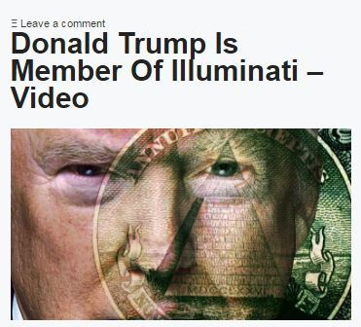
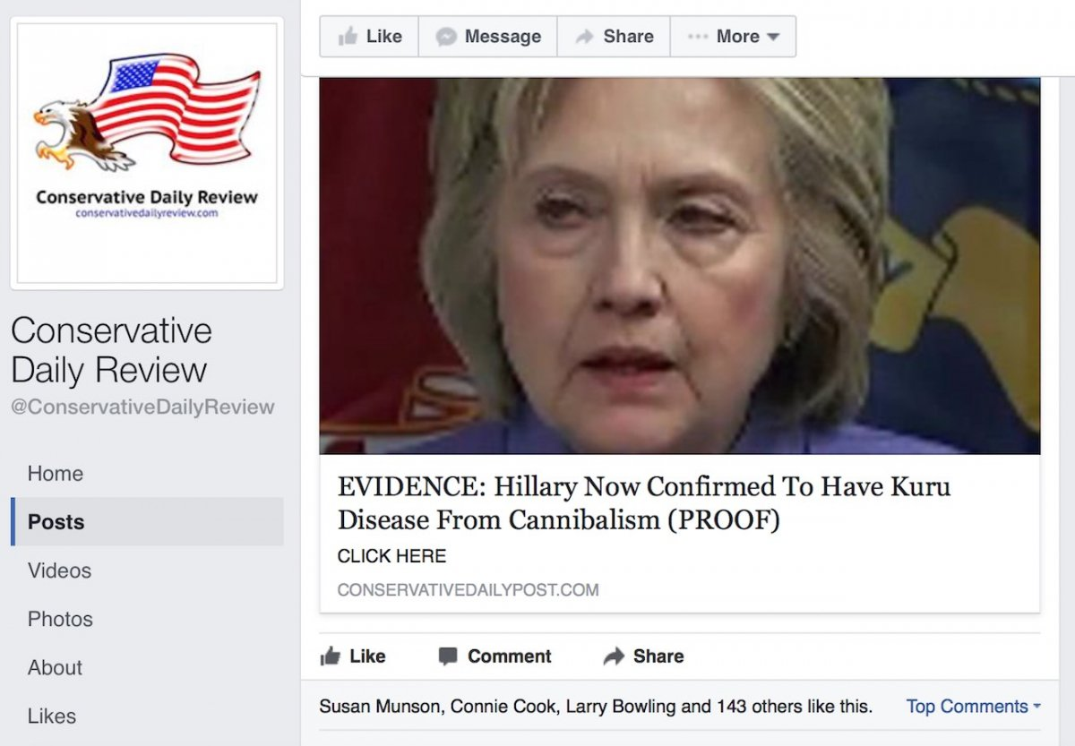
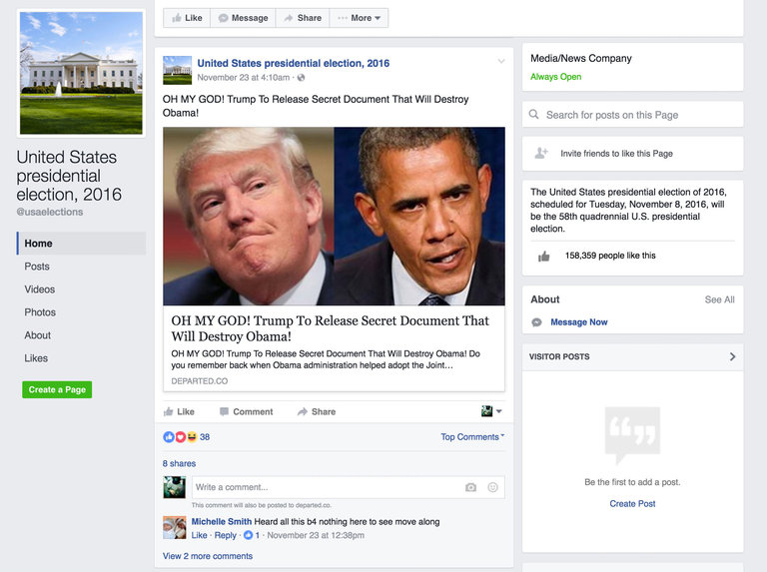
New media & the ‘fake new’ ‘alt facts’ moment

Slide 18
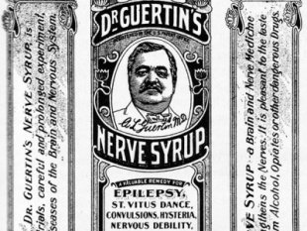
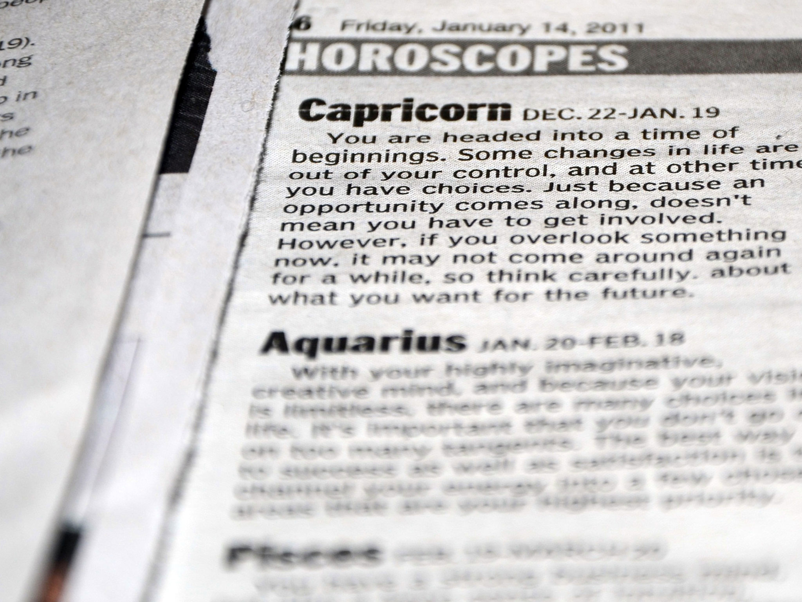
But we’ve always believed junk (many of us, anyway)

Slide 19
Your real horoscope

Slide 20
Common sense (‘intuitive theories’ (Nichols))

Slide 21
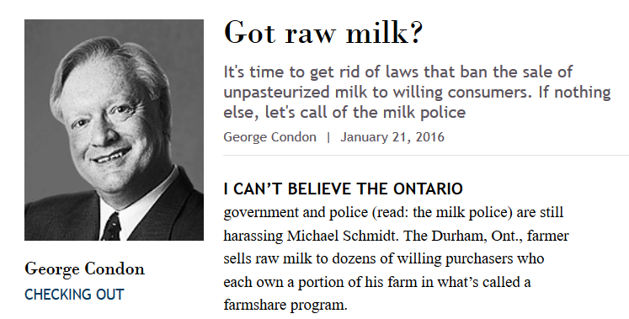

Slide 22
Nichols on common sense:

Slide 25
*break time*

