Slide 1
Anti-science in politics and policy

Slide 2
What is the percentage of climate scientists who believe we are undergoing climate change?

Slide 3
Approx. 98.4% (Cook et al. 2004) Approx. 97-98% (Anderegg et al. 2012) Approx. 90% (Verheggen et al. 2014)

Slide 4
Study by Yale/George Mason (2017)

Slide 5
Anti-science in policy

Slide 6
US policy on climate change
“I'm not a big believer in man--made climate change.." — Trump Sept. 21, 2015
“Well, I think the climate change is just a very, very expensive form of tax.. A lot of people are making aa lot of money.." — Trump Jan 18, 2016
“We’re going to cancel the Paris climate agreement.." — Trump, May 26, 2016

Slide 7
U.S. federal agencies are striking “climate change” from websites
Since Trump took office, the phrase “climate change” has been disappearing from government websites. Agencies including the Department of Energy, the Environmental Protection Agency, the Department of Health and Human Services, and the Department of Transportation have all had websites or press releases scrubbed of references to humanity’s role in rising average temperatures.
HHS, for example, buried references to a document on climate change and human health from its website and removed “climate change” from navigation menus. The EPA, meanwhile, said it was removing “outdated language” from its sites as it deleted pages relating to regulations around climate change.

Slide 8
The CDC asked employees to refrain from using certain words in budget documents
The words, which were not to be used in documents circulated in the administration and Congress ahead of the budget proposal for 2019, included “evidence-based,” “science-based,” “vulnerable,” “entitlement,” “diversity,” “transgender,” and “fetus.” The agency has since denied the existence of a “banned words” list.
But discussions about language sensitivities in budget talks did take place. A former CDC official told Vox it’s not uncommon for officials to avoid using language in budget discussions that might offend those holding the purse strings.

Slide 9
We had one too – the Harper regime
The Conservatives clamped down on environmental science, from research on climate change to studies on the state of Canada’s rivers, lakes, and forests through re-routing money away from federal institutions and projects they didn’t like.
Harper introduced measures that made it difficult for federal scientists to share their work with the public.
Axed the National Science Advisor position
Scrapped the mandatory long-form census (which took a deep dive into the demographic make up of the Canadian population),
Slashed funding into research on Canada’s ozone layer above Canada)
Ended several national roundtable, including one on the Environment and the Economy (a Canadian advisory agency focused on sustainability).

Slide 10
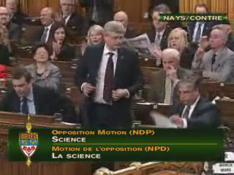
Low point in our own history:
In 2013, Members of the House of Commons debated a motion put forward by NDP Science and Technology critic, Kennedy Stewart. The motion reads as follows:
That, in the opinion of the House,
a) public science, basic research, and the free and open exchange of scientific
information are essential to evidence-based policy-making;
b) federal government scientists must be enabled to discuss openly their findings with
their colleagues and the public;
c) the government should maintain support for its basic scientific capacity across Canada, including immediately extending funding, until a new operator is found, to the world-renowned Experimental Lakes Area Research Facility to pursue its unique research program.
The governing conservative party cheered as they defeated the motion, 157 against to 137 for.

Slide 11
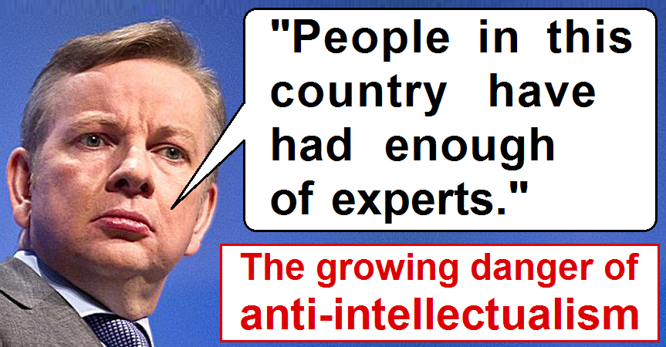
The Expert Crisis

Slide 13
What is an expert? Who is an expert? (Nichols)

Slide 14
Tom Nichols (The Death of Expertise):

Slide 15
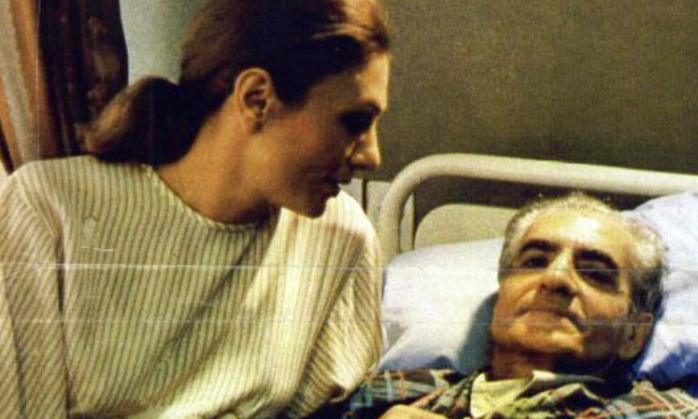
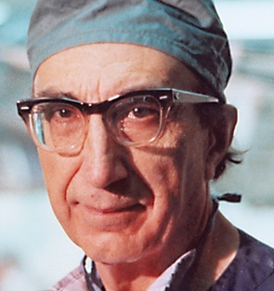
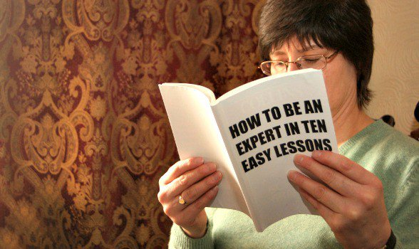
When ‘experts’ get it wrong (and why)
Over-confidence (more humility, less hubris, pls!):
They’re not really experts at all
Fraud (cold fusion – Pons & Fleischmann; various fake cancer studies)

Slide 16
Nichols on ‘loopholes’

Slide 17
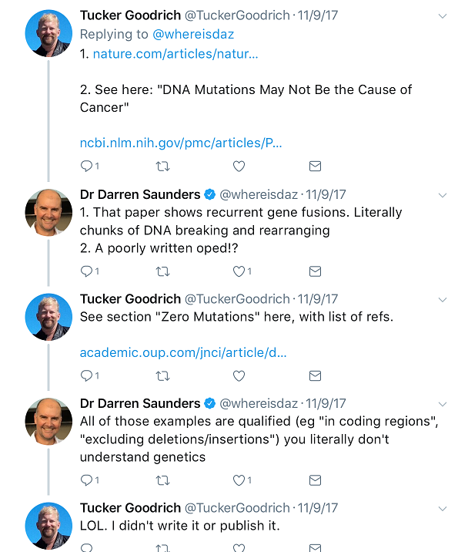

Slide 21
“It is a common misconception that doctors know about medicine, simply because they’ve studied it for up to 16 years.” – Deacon, 2016.

Slide 23
*break time*

