Slide 1
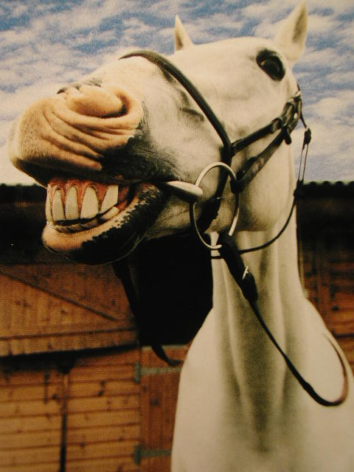
Info and false info

Slide 3
Where do most people get their information from?

Slide 10
Evaluating information sources
To avoid using the acronym CRAAP – which is not a great acronym for a system for evaluating … um .. good info from crap … let’s switch out Currency for Timeliness and make it TRAAP.

Slide 11
The T.R.A.A.P. Test
Timeliness, Relevance, Authority, Accuracy, and Purpose/Point of View
Developed by Librarians to help students assess the value of information collected for research/student projects.
Although I’ll be showing you lots of techniques for assessing information, this is a good one for us to start with.

Slide 12
Timeliness
When was the information published or posted?
Has the information been revised or updated? When? Recently?
Is it current enough for your topic?

Slide 13
Relevance
Does the information relate to your topic?
Does the information meet the stated requirements of the assignment?
Is the information at an appropriate level (i.e. not too elementary or advanced for your needs)?
Who is the intended audience?
What kind of information is included in the resource?
Is better information available elsewhere?

Slide 14
Accuracy
Is the information accurate?
Are there spelling, grammar or other typographical errors?
Where does the information come from?
Does the creator provide references or sources for data or quotations?

Slide 15
Authority
Who is the creator or author?
What are the credentials or qualifications to write on the topic?
Who is the publisher or sponsor? Are they reputable?
Is there contact information, such as publisher or email address?
Does the URL reveal anything about the author or source? (examples: .com, .edu, .org, .net, .gov)

Slide 16
Purpose/Point of View
What is the purpose of the information? To inform? Teach? Sell? Entertain? Persuade?
Is the information fact? Opinion? Propaganda?
Does the point of view appear objective and impartial?
Are there political, ideological, cultural, religious, institutional or personal biases?

Slide 17
Looking at Some “Fake Info”

Slide 18
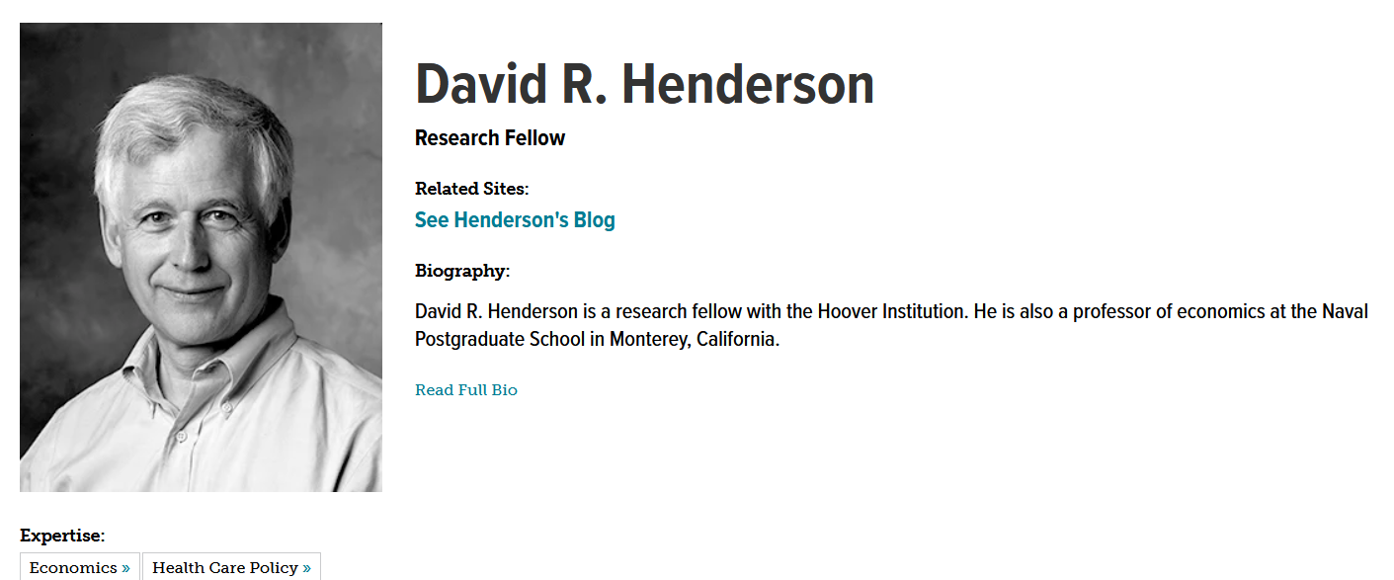

Slide 20
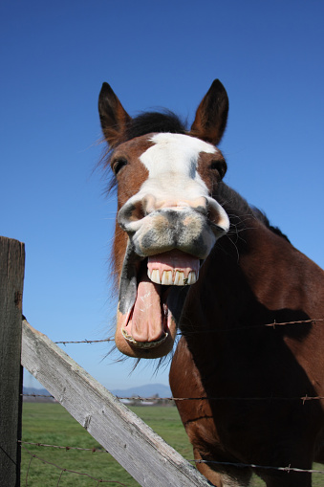
What does the US Food & Drug Admin. say?

Slide 23
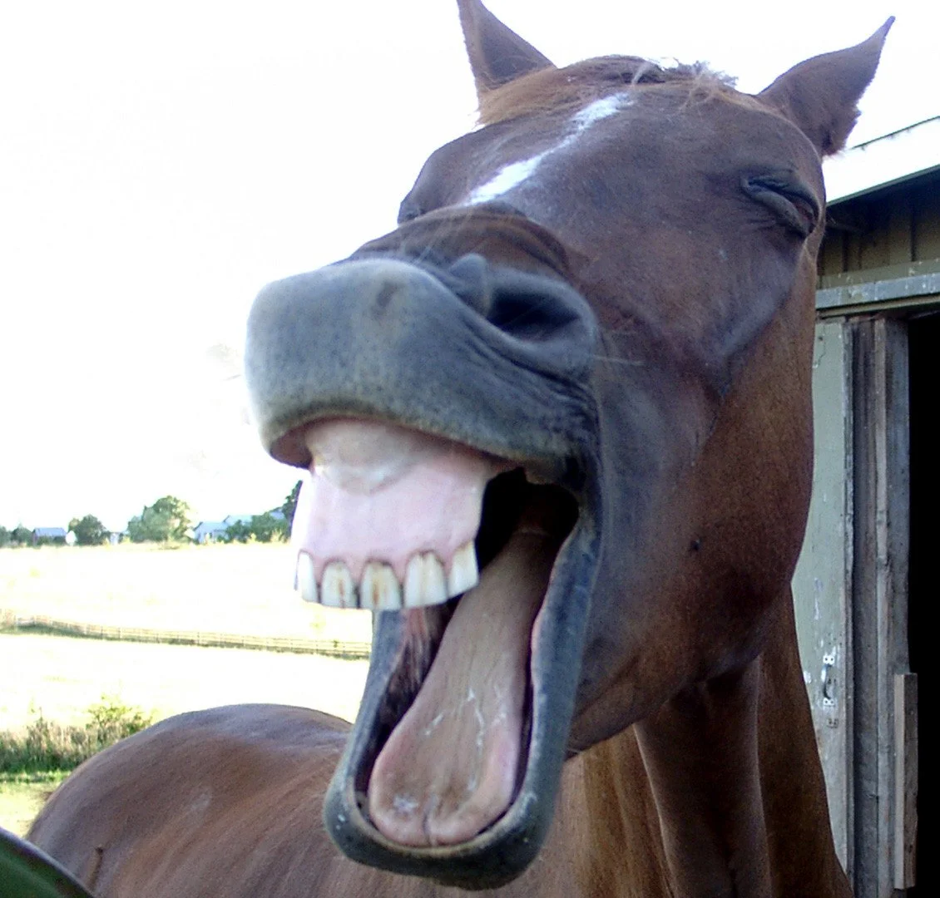
Alberta Health Authority

Slide 25
Countering mis-information

