Slide 1
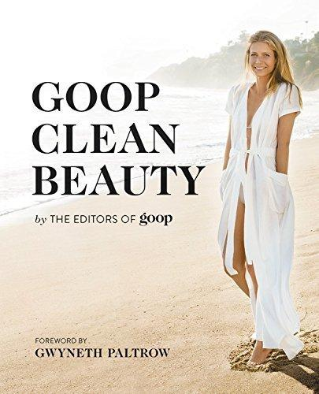
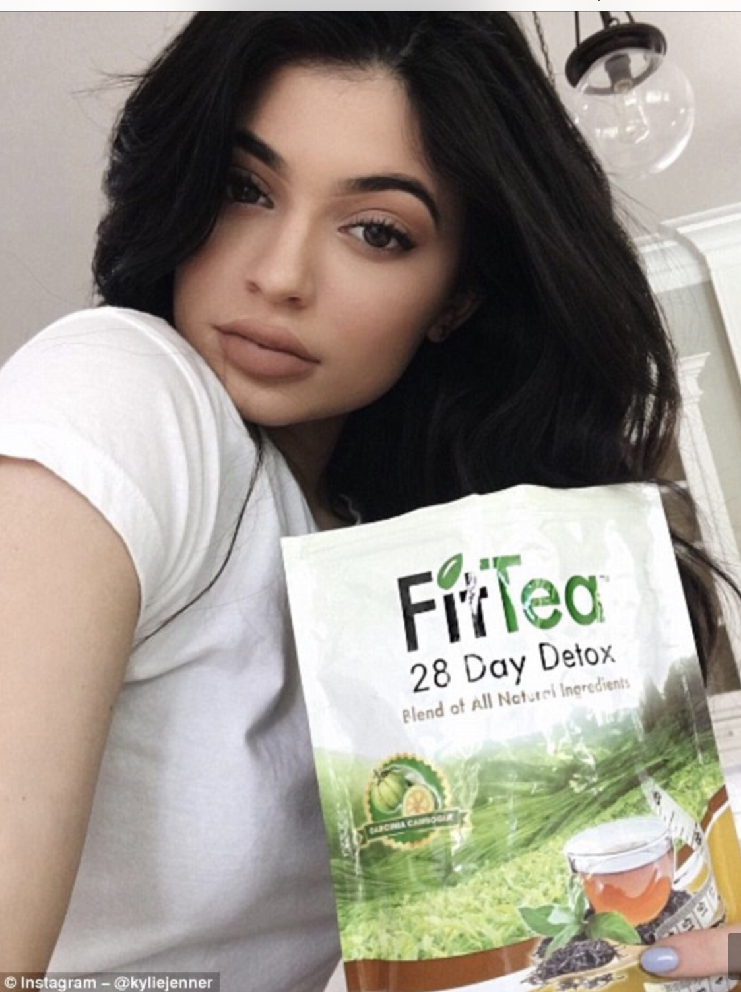
Celebs, pseudo-celebs and ‘wellness fads’

Slide 3
Celebrity diets: the WORST

Slide 4
One of the first diets backed by a medical doctor

Slide 7
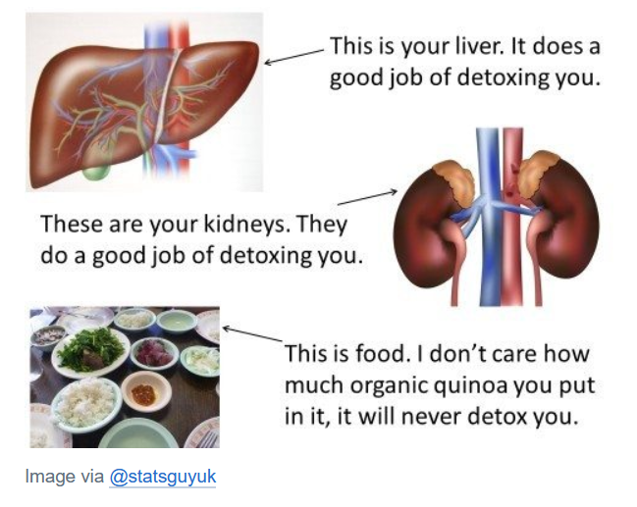
Caulfield:
Weight loss and diet gimmicks never work and are rarely supported by actual science.
All novel, apparently simple solutions to vague health problems are likely bogus.
You don't need to detox, cleanse, juice, hyper-hydrate, supplement, etc.

Slide 8
Caulfield cont’d:
Very little reliable science can be seen to support many of the claims that flow from the beauty and anti-aging industry.
Celebrity culture encourages a range of unhealthy behaviour (like smoking and suntanning).
Celebrity culture helps us to set unrealistic beauty norms and makes us feel bad about ourselves and our looks.

Slide 9
Message: you’re perfect as you are (with filters)

Slide 10
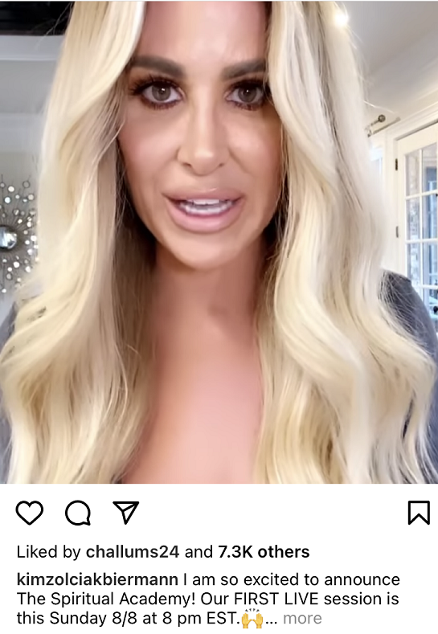
Caulfield cont’d:
Celebrity culture encourages uncritical, magical thinking.

Slide 11
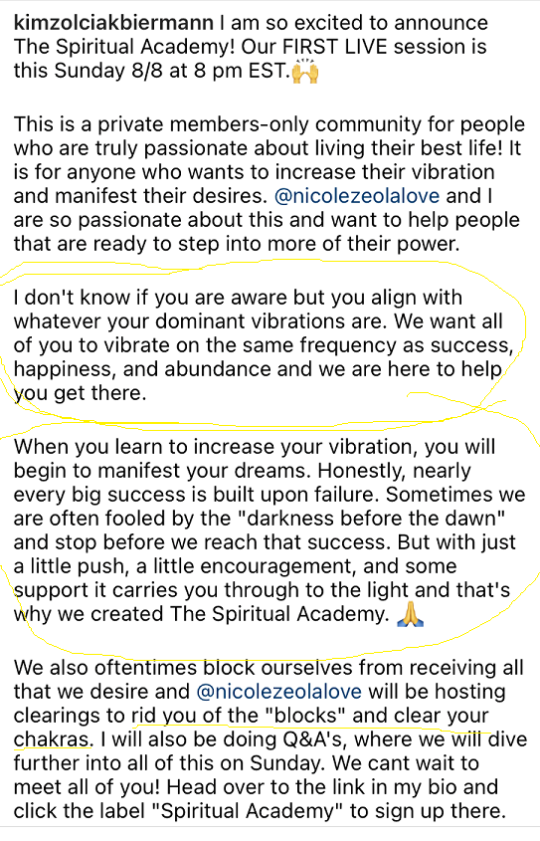

Slide 14
Other ‘wellness’ nonsense

Slide 15
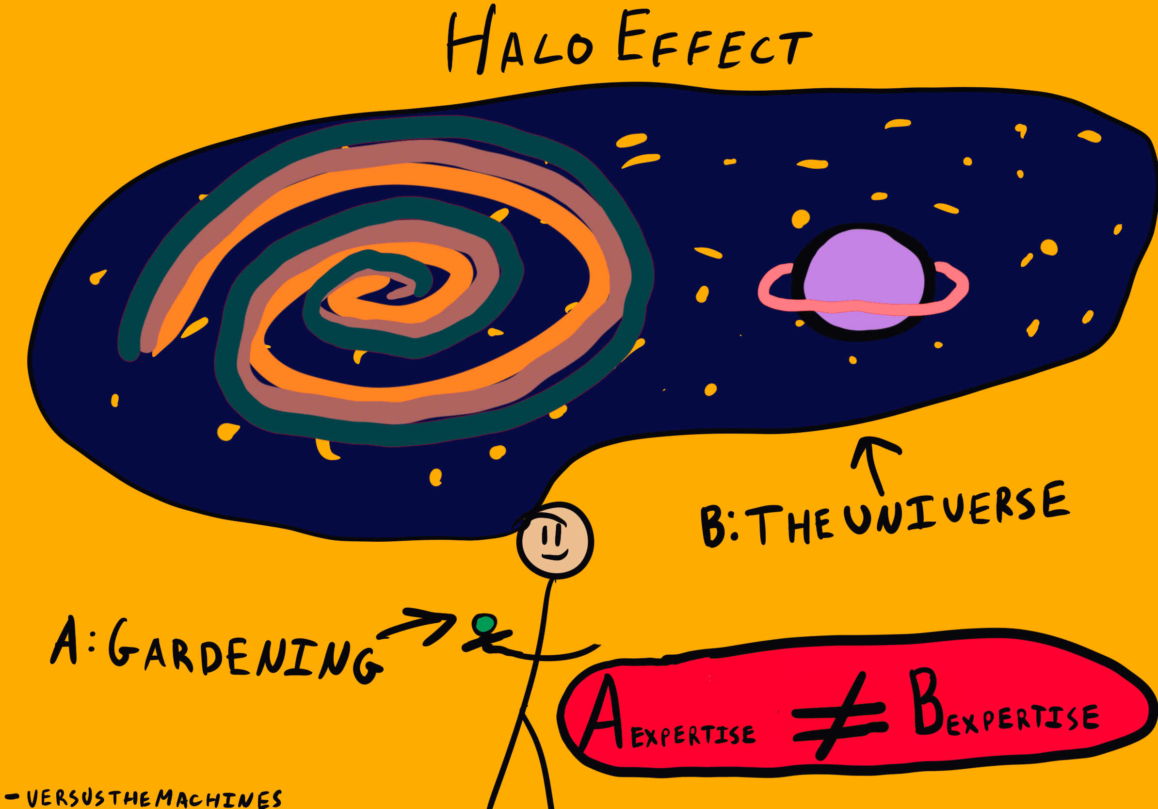
Why do we believe nonsense from celebs and pseudo-celebs?
Halo effect: our positive impressions of someone – usually based on their looks and demeanour – cause us to be more likely to attribute positive things to them (and to believe them). The better looking, the more gullible we can become.
Decision Lab

Slide 16
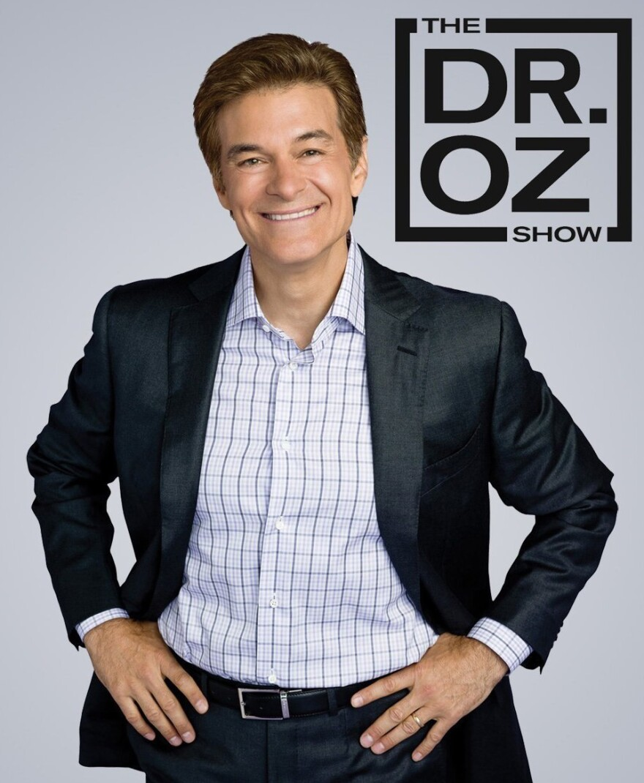
Authority bias: this is our tendency to respect and follow someone who is seen as a leader or expert.
Dr. Oz: Cardio-thoracic surgeon.
In 2014, a study published in the British Medical Journal found that for “recommendations in The Dr Oz Show, evidence supported 46%, contradicted 15%, and was not found for 39%.”

