Slide 1
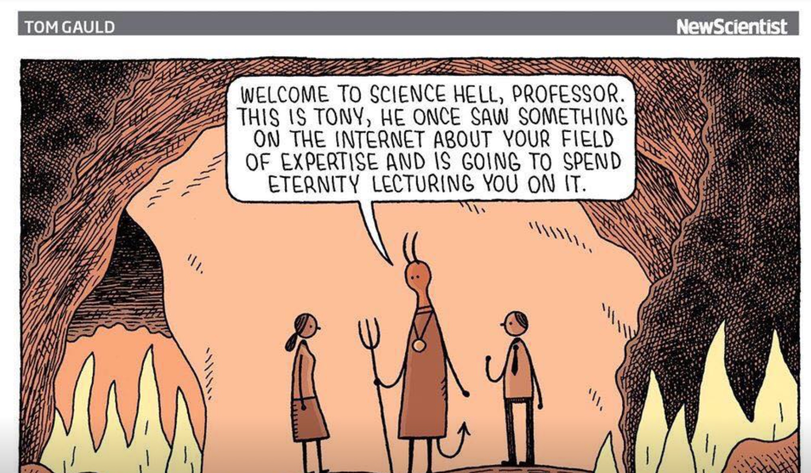
Expertise

Slide 2
Kahneman, Sibony and Sunstein (2020):
Experts vs Respect-Experts
They define an “Expert” as someone with recognized qualifications –specialized training, a title, etc.
They define a “Respect-Expert” as someone who has professional qualifications and training, but is also recognized and respected as a peer and expert by other experts in the field

Slide 3
How to become a media expert

Slide 4
1. 'Magic' weight-loss compounds (raspberry ketones, green tea)
2. GMOs are unhealthy
3. Cures for the common cold (Umckaloabo Root Extract)
"There is weak evidence that [this] extract could shorten the length of respiratory tract infections and relieve symptoms," according to the National Institutes of Health. "But these extracts can have side effects like stomach and bowel problems."
4. Cure for restless legs
5. Teeth whitening (strawberries and baking soda??)

Slide 5
Why people distrust experts
Access to an array of information – good, bad, and terrible
Credible sources of information are often only readable by other experts in the field – academic jargon, specialist know-how
Credible sources are often ‘paywalled’ & therefore not accessible
Lack of agreement among experts allows cherry-picking
Scientific fraud
Scientific error
Politicization of science
BUT THE NUMBER ONE ISSUE (ACCORDING TO ME):

Slide 6
Lack of understanding of how science works

Slide 7
Julian Sanchez has something to say about the problem with this:

Slide 8
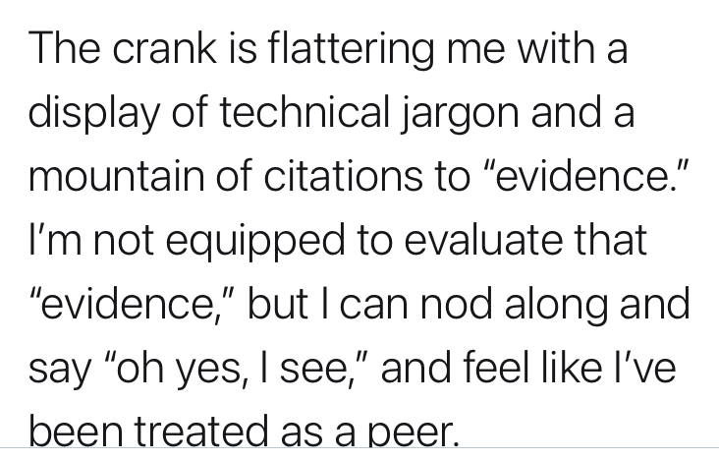

Slide 10
One of my Favourite Examples:

Slide 13
Connecticut EMS Advisory Board (Training & Education Committee):

Slide 15
Another scholar from the University of Facebook

Slide 16
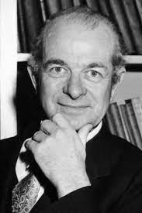
When experts get it wrong - Pauling
Linus Pauling
A Nobel Prize winning chemist for his work in molecular biology
Also a Nobel Prize winner for his peace activism
Considered one of the top 25 scientists of all time
Spent the last 25 years of his life completely wrong

Slide 17
Vitamin C
In his later years he was diagnosed with Bright’s Disease and became interested in the use of vitamins as preventative/curative
He focused on Vitamin C and became influenced to adopt a ‘mega-dosing’ regimen, which he then publicly advocated.
He event conducted studies purporting to show that vitamin C increased survival in terminal patients by as much as four times compared to untreated patients
Small problem: a tonne of careful research – including research generated in Pauling’s lifetime – showed no such effects AND his research was demonstrated to have significant flaws.

Slide 18
When faced with evidence he was wrong, what did Pauling do?
He REFUSED to admit he was wrong
He doubled down and accused other scientists of committing errors and/or fraud
I call this ‘doubling down on a bad bet’, but psychologists call this the ‘sunk cost’ fallacy. In management studies it’s known as ‘escalation of commitment’. This occurs when someone has invested so much into a particular belief or course of action that instead of acknowledging the possibility of error, they maintain or increase their commitment.
In Pauling’s case, being an ‘expert’ probably didn’t help his ego & made it more likely he’d stick to his position.

Slide 19
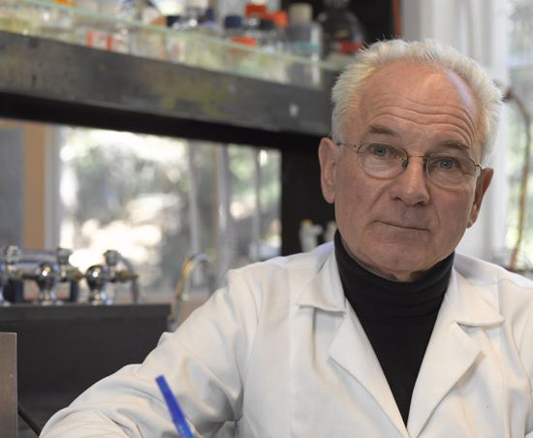
Duesberg and HIV
Peter Duesberg is a Professor at Berkely known for his work on oncogenes– genes that have the ability to cause cancer
Initially highly regarded for his cancer work, he proposed a hypothesis that has been highly disputed: AIDS is caused by long-term consumption of recreational and/or antiretroviral drugs and not HIV.
Although this view has been extensively de-bunked, it was picked up by the South African Mbeki government and became public policy there.
Mbeki denied antiretroviral drugs to citizens, claiming they were “poison” from the pharmaceutical industry, resulting in an estimated 300,000 preventable deaths.

