Slide 1
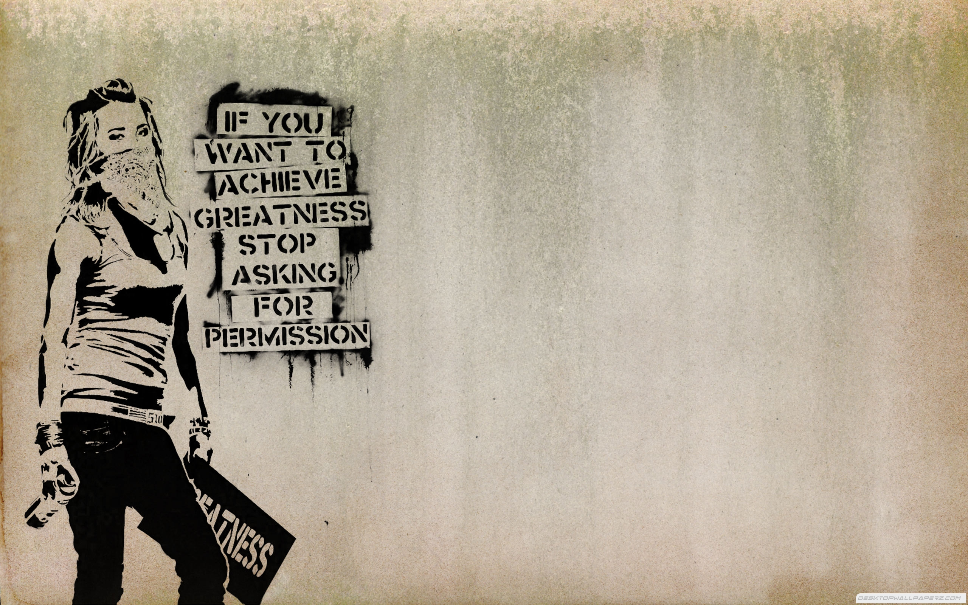
The art of dissent

Slide 2
Dissent

Slide 3
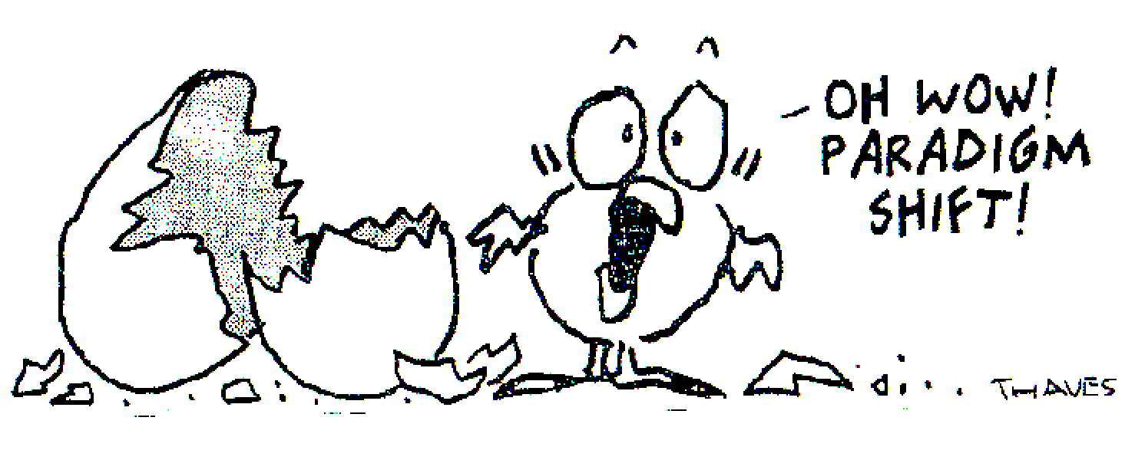
Paradigm and paradigm shifts (Kuhn)
Paradigm: "universally recognized scientific achievements that, for a time, provide model problems and solutions for a community of researchers“ …"Paradigms gain their status because they are more successful than their competitors in solving a few problems that the group of practitioners has come to recognize as acute."

Slide 4
Paradigm shift: completely changes the scientific theory itself and radically alters the way in which it seeks to understand reality.

Slide 5
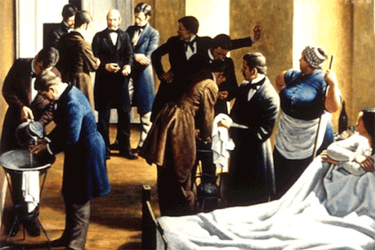
Paradigm shifting (and the Semmelweis reflex)
“The Semmelweis reflex or ‘Semmelweis effect’ is a metaphor for the reflex-like tendency to reject new evidence or new knowledge because it contradicts established norms, beliefs or paradigms.”

Slide 6
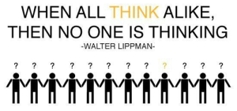
Groupthink (Kaplan)

Slide 7
Dissent and fear (Kaplan)

Slide 8
Dissent within organizations

Slide 9
Power vs. status (Grant)

Slide 10
Special cases – gender (Grant)

Slide 11
Special, special cases – double minorities (Grant)

Slide 12
The middle-manager problem

Slide 14
Idiosyncracy credits (Hollander)

Slide 15
What might be some ways in which a potential change agent could accrue idiosyncracy credits?

Slide 16
*break time*

